Slide 1
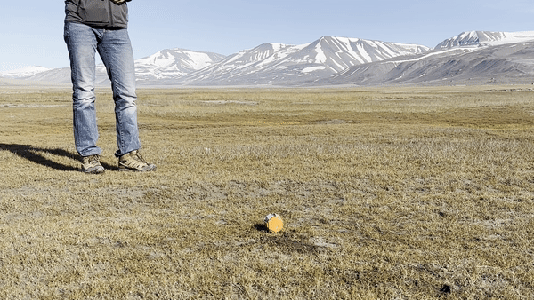
HexSense – 2024 Canary Islands Mission
Monitor the environment condition inside lava
Tubes.

Slide 2
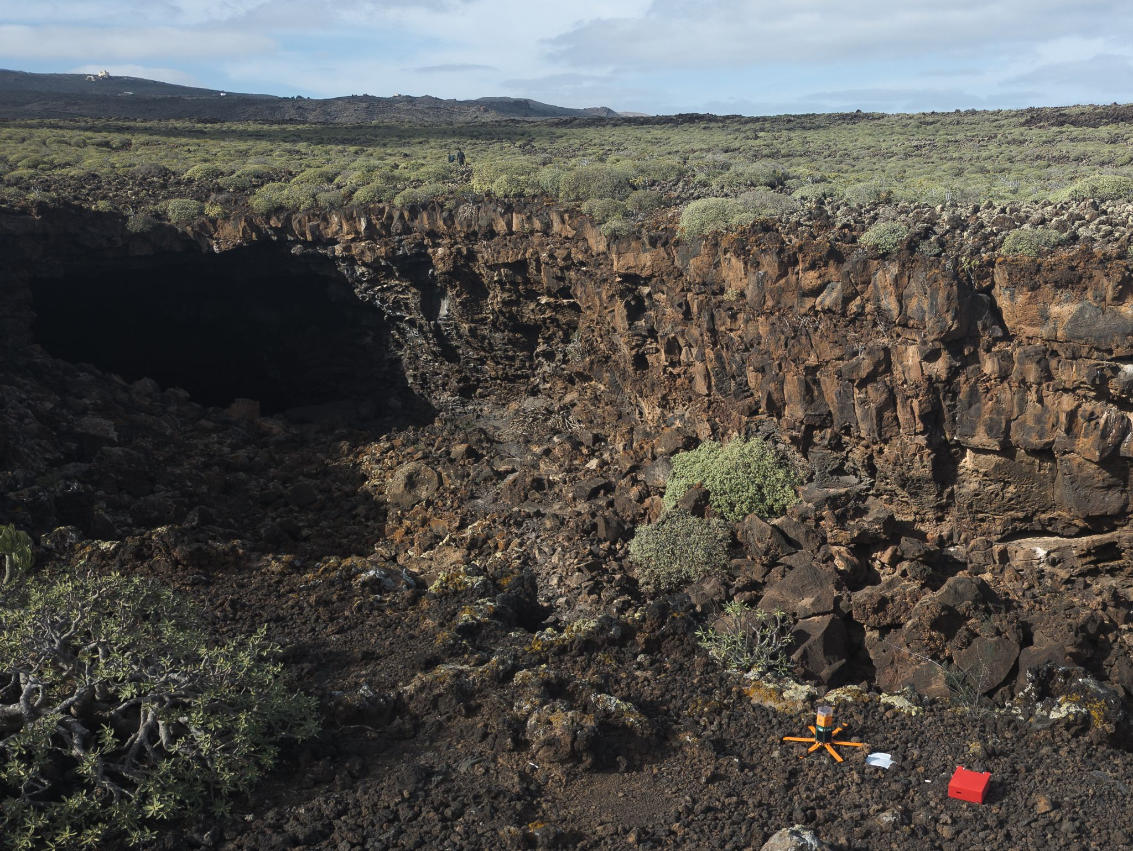
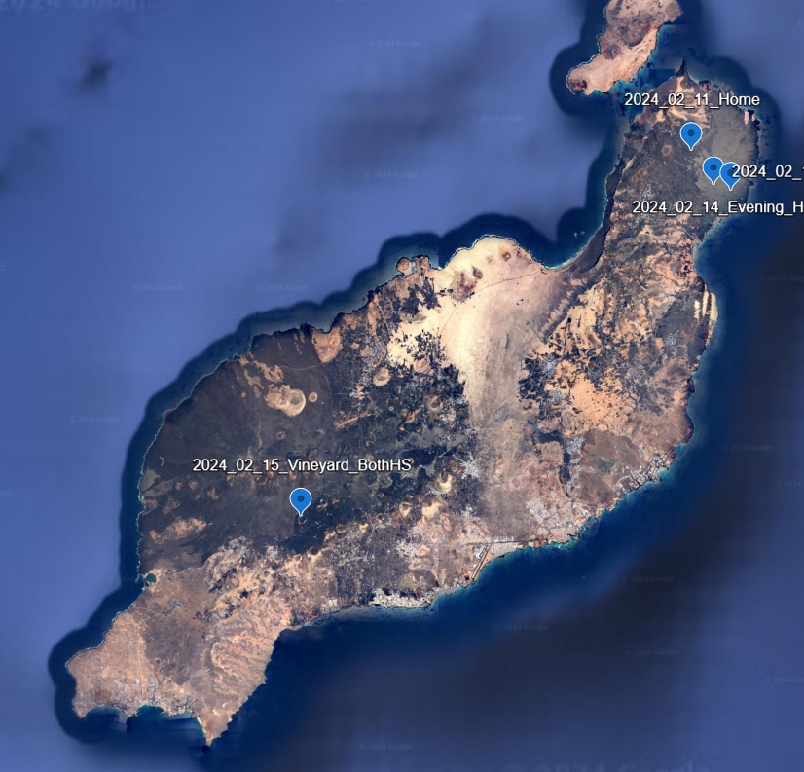
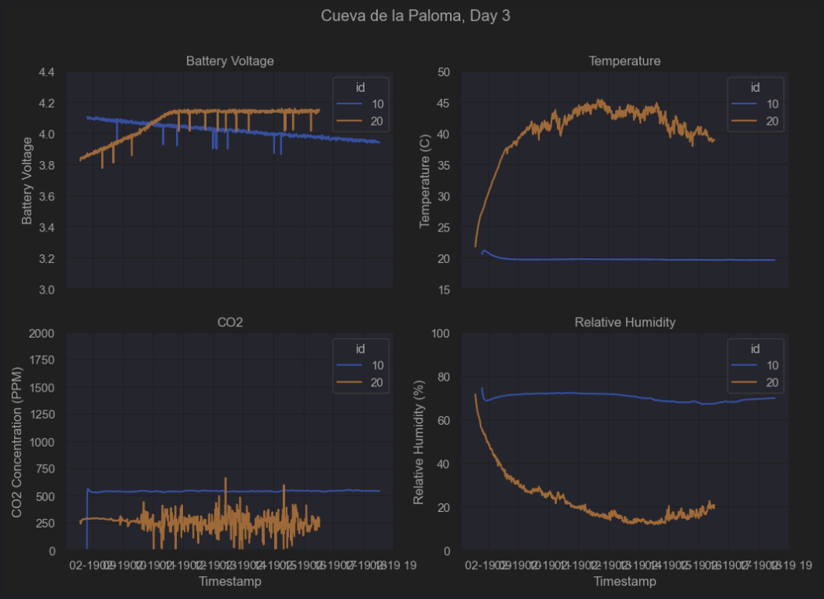
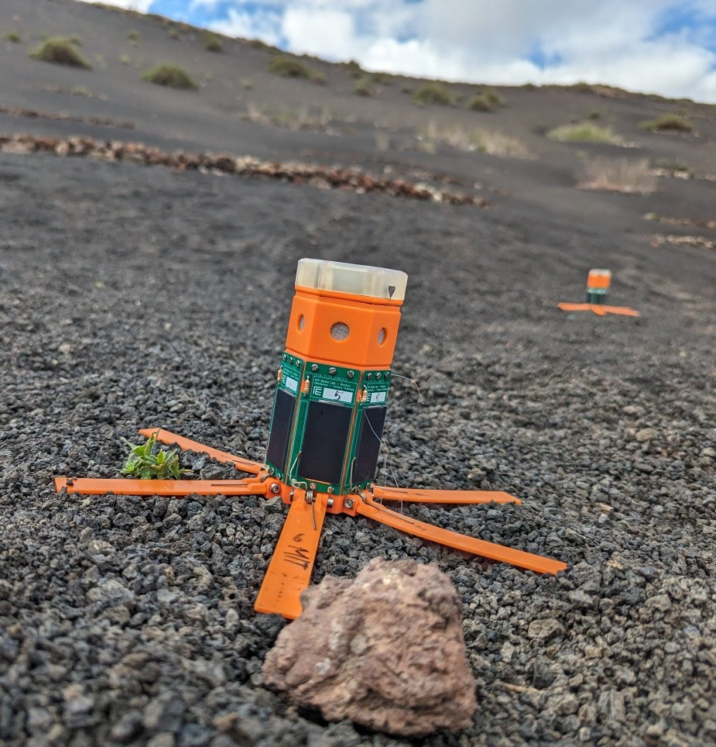
HexSense – 2024 Canary Islands Mission
Monitor the environment condition inside lava
Tubes.

